Slide 1
CMSC 426 Principles of Computer Security
Malware Lifecycle and Analysis

Slide 2
Last Class We Covered
Types of malware
Well-known malware families
Gratuitous examples of malware

Slide 3
Any Questions from Last Time?

Slide 4
Today’s Topics
Malware lifecycle
Intro to malware analysis
Indicators of Compromise

Slide 5
Malware Lifecycle

Slide 6
Infection Lifecycle
Timeline between when malware gets delivered to a system and when it gets done running
Everyone has their own spin, but here’s a simple one:
Initial infection of victim occurs
First-stage malware on victim’s computer
Payload is delivered
Malware takes action
Malware makes contact with actor
“Command & Control”

Slide 7
Infection Vector Example: Phishing
Using email to convince a victim to click a link or download an attachment
Initial infection occurs via this act
Spearphishing
Phishing of specific, chosen victims
Higher rate of success

Slide 8
Infection Vector Example: Exploit Kit
Compromised website redirects to a malicious website that is hosting the exploit kit
Exploit kit does what it says on the box:
Scans the victim’s computer for vulnerabilities
Sends an appropriate exploit to the victim’s computer
Allows delivery of malware
Patching exploits (allowing updates) is incredibly important
When patched, redirects can still happen, but exploit kit won’t have anything to exploit

Slide 9
First-Stage Malware
A full malware payload is rarely delivered directly through the initial infection vector
The “first-stage” malware gets execution on the victim’s computer, then downloads and runs the payload
May be referred to as droppers, loaders, downloaders, etc.
Most of the time, only first-stage malware is delivered
What purpose does this serve?
Most email clients don’t allow executable attachments
First-stage can be smaller in size, with its limited functionality

Slide 10
First-Stage Example: Malicious Macros
Files that contain macros that are attached to phishing emails
With the intention of the user running the macro and downloading/running the full payload
Often Microsoft Office documents, RTF files, or PDFs
Office documents used to automatically run macros when a user opened the file
Now a notification (often including a warning) is shown to the user requiring them to manually enable macros
(Many users just click “Enable Content” anyway)

Slide 11
Payloads
The actual file(s) that perform the malicious actions and achieve the actor’s end goal
We talked about the different categories of payloads last time
Direct actions, like ransomware and cryptojacking
End goals, like making the machine part of a botnet, or setting up long-term monitoring with a RAT
The parts of the malware that actually do the “cool stuff”

Slide 12
Command & Control
Malware’s communication of information with the actor
Banking Trojan – send login credentials when seen
RAT – constant possible interaction
Botnet – centralized C&C (master)
End of the lifecycle (but this “end” can be very extended)
Often referred to as C2 or C&C
Payloads often connect back to a C&C IP address or domain in order to receive instructions from the malware actor

Slide 13
Missing Command & Control
Not every malware has a C&C stage
Depends on malware’s actions and end goal
Ransomware
Victim communicates “directly” with the actor
Wiper
No communication necessary

Slide 14
Indicators of Compromise

Slide 15
Review: Indicators of Compromise
Evidence that malware was on a system/network
Can be used for attribution to a malware family, actor, and/or campaign
Examples:
IP addresses and domain names
Email addresses
Cryptocurrency wallets
Hashes

Slide 16
IP Addresses and Domain Names
Can show up in different instances:
IP address or domain name the malware downloaded from
IP address or domain name that the malware uses for C&C
Quick reminder:
IP address:
192.168.0.1
Domain name:
google.com

Slide 17
Email Addresses
Can show up in different instances:
Email address used to send a phishing email
(May be spoofed, however)
Email address used to register a domain name
Not actually provided in the malware, but possible to look up who registered the domain name
With that information, possible to find out what other domains have been registered by that actor

Slide 18
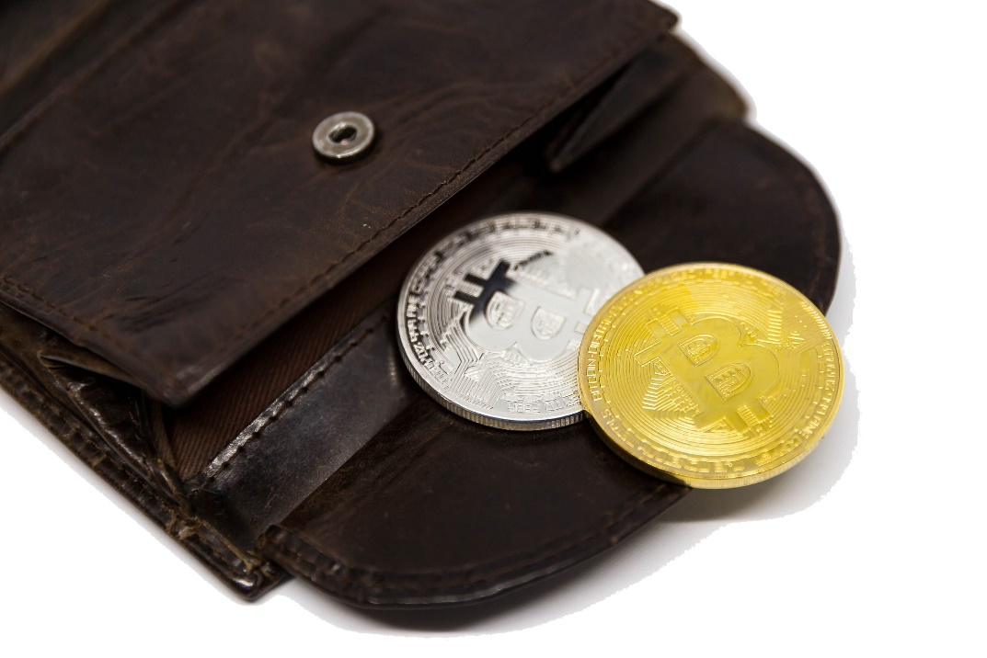
Cryptocurrency Wallets
Can show up in different instances:
Wallet listed in a ransomware note
Easy to find, for obvious reasons
Wallet that a cryptocurrency miner “deposits” into

Slide 19
Hashes
Unique large number calculated by a hashing algorithm
In other words, the output of the hashing algorithm
Sometimes called the “digest,” often just called the “hash”
If two files share the same hash, there is an exceedingly high probability that the files are identical
Hashing algorithm may be run on any malware file
Files in payload, in first stage, etc.

Slide 20
Side Note: Hashing
If two files have the same hash, they are functionally identical
Sort of allows a “diff” without having both files together
If even one small change is made, the hash will change drastically (may be entirely different)
Different hashing algorithms generate different sizes of hash
MD5, SHA1, and SHA256 are most common algorithms
(16, 20, and 32 byte hashes are generated, respectively)

Slide 21
Import Table Hashing
Import address table is metadata within payload files
Contains list of all library functions used, in order they appear in code
Created by the original compiler/linker as the file is compiled/linked
Hashing the import table gives you an imphash
“import hash”
If hashing the whole file, a single change ➔ different hash
If an imphash, changes would have to be more substantial
But still unique-ish – variants will likely have different import tables

Slide 22
Fuzzy Hashing
Official name is “context triggered piecewise hashing”
Most common program used for this is called ssdeep
Details of how it works are complex, but essentially:
More robust against changes than traditional hashing
Can compare two fuzzy hashes and get a similarity score

Slide 23
DEMO TIME!

Slide 24
Announcements
Homework 1 is up on the course Blackboard
Due at midnight on Wednesday, October 3rd
Lab 2 will come out that same Wednesday
Midterm 1 is on Tuesday, October 9th

Slide 25
Image Sources
Bitcoin wallet (adapted from):
https://www.flickr.com/photos/30478819@N08/24874103608

